Slide 1

Cybersecurity Solution Proposal For Chris Hani Hospital Ransomware Crisis.
Prepared by InnovateIT
InnovateIT company members:: Zoko Aphile
Mashobane Erwin
Kabuya Josue
Mathikge Kamogelo
Vitshima Zukhanyise

Slide 2
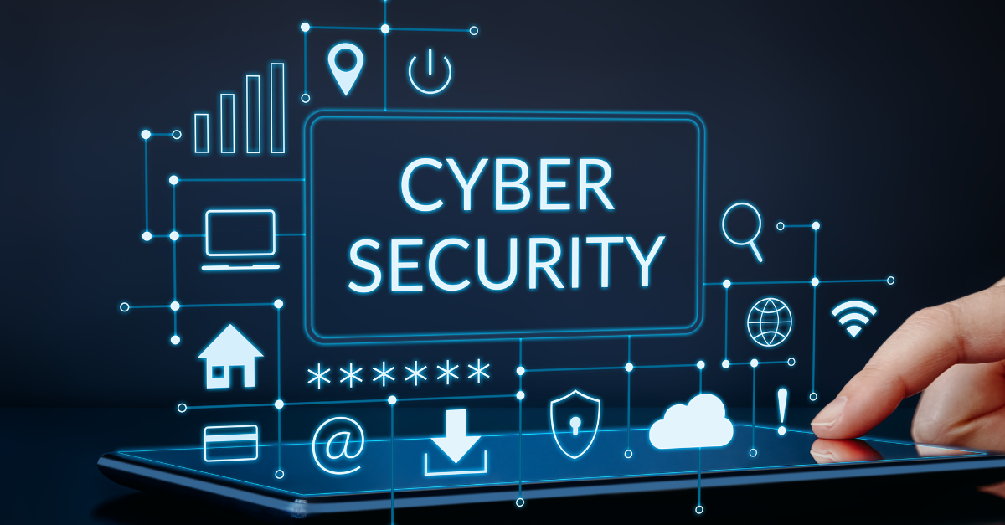
INTRODUCTION TO CYBERSECURITY IN THE 21ST CENTURY.
Cybercrime refers to illegal activities conducted through computers or networks, including hacking, identity theft, ransomware and online scams. The risk of cybercrime continues to grow as more people rely on online banking, e commerce and social media. Cybercriminals have now advanced by using tools like artificial intelligence and deepfakes to trick victims making it increasingly difficult to separate legitimate information from malicious attacks. These cyber attacks not only cause financial losses but also emotional stress and a loss of trust in digital systems.

Slide 3

Ethical Elements And Professional Conduct
Ethical Conduct & Professional
Cybersecurity professionals must act with integrity, confidentiality, and accountability. The (ISC)² Code of Ethics focuses on protecting society, acting legally and honorably, providing competent service, and advancing the profession. The ISACA Code promotes diligence, objectivity, and reporting unethical practices.
Legal & Regulatory Compliance
In South Africa, the Cybercrimes Act (2020) and POPIA require data protection and legal reporting. International standards like ISO/IEC 27001 promote accountability and secure information management.
Ethical Training & Culture
Continuous ethical training builds awareness and ensures responsible data handling
Stakeholders
Management, IT teams, medical staff, patients, consultants, and authorities must collaborate to ensure data security and effective crisis response.
Conclusion
Ethical behavior, compliance, and teamwork create a trustworthy and resilient cybersecurity environment.

Slide 4

Causes Of Attacks And Loopholes
Potential causes of attacks and loopholes in Chris Hani Hospital:
Outdated software and unpatched operating systems
Weak or reused passwords and the absence of multi factor authentication
Inadequate staff training on cybersecurity awareness
Poor network segmentation
A lack of regular data backups or secure offsite storage
Phishing emails, compromised links and malicious attachments that employees unknowingly click

Slide 5


Immediate Response And Crisis Management
Activate the incident response plan and isolate infected systems.
Disable Wi-Fi, remote access, and shared drives to stop the spread.
Alert staff, preserve forensic evidence, and consult cybersecurity experts.
Do not pay the ransom restore from verified backups or use trusted decryption tools.
Reinstall clean systems, apply multi-factor authentication, and enhance network security.
Use manual processes and offline records to continue patient care.
Communicate transparently with staff, patients, and authorities.
Turning off infected systems may disrupt care but prevents further damage.
Invest in backups, staff training, and disaster recovery plans to strengthen future resilience.

Slide 6

Our Solution Proposal (InnovateIT)
Our team at InnovateIT is ready to help the hospital recover from the ransomware attack and prevent future incidents. We combine technical expertise, crisis management experience, and innovative solutions tailored to healthcare systems.
Our key strengths:
Technical Expertise
Crisis Management
Long term security planning
Legal and ethical compliance
Innovation and forward thinking
In summary, selecting InnovateIT means choosing a team that can restore your IT systems quickly, protect patient data, prevent future attacks, and create a secure, innovative digital environment. Our goal is not just recovery, but building a safer and smarter hospital for the future.

Slide 7

Conclusion And Reference
To conclude with a famous quote by Nicole Eagan:Cybersecurity isn’t just about protecting data, it’s about protecting trust.
References:
Britannica (2024) Cybercrime. Available at: https://www.britannica.com/topic/cybercrime (Accessed: 17 October 2025).
ISC². (2023). Code of Ethics. International Information System Security Certification Consortium.
Symantec (2022). Cybersecurity Threats in Healthcare Networks. NortonLifeLock. Available at: https://www.symantec.com [Accessed 6 Oct. 2025].
Cybersecurity and Infrastructure Security Agency (CISA) (n.d.) #StopRansomware Guide. Available at: https://www.cisa.gov/stopransomware/ransomware-guide (Accessed 19 Oct 2025).

